Slide 1


Social Buzz Trends

Slide 2


Today's agenda
Project recap
Problem
The Analytics team
Process
Insights
Summary

Slide 3

Company: Social Buzz is a social media platform that allows users to share and react to content.
Tasks :
Audit of big data practice: This task involved assessing Social Buzz's big data infrastructure and processes.
Recommendations for a successful IPO: This task involved providing Social Buzz with recommendations on how to prepare for an IPO.
Analysis of content categories: This task involved identifying the top 5 content categories with the largest aggregate popularity.
Project Recap

Slide 4

Problem
Social Buzz is a social media platform with over 500 million active users each month.
The platform is overwhelmed with content, with over 100,000 pieces of content posted every day.
This makes it difficult for Social Buzz to capitalize on its user base and identify the best performing categories.
Therefore Social Buzz needs to analyze its content categories to identify the top 5 categories with the largest aggregate popularity.

Slide 5
Benefits of Analysis
Increase user engagement
Improve content discoverability
Drive more traffic to the platform
Generate more revenue

Slide 6



Andrew Fleming
Chief Technology Architect
The Analytics team
Marcus Rompton
Senior Principal
Arif Shaikh
Data Analyst

Slide 7
Process
1
Data Gathering & Understanding
2
Data Cleaning
3
Data Modeling
4
Data Analysis
5
Data Visualization

Slide 8
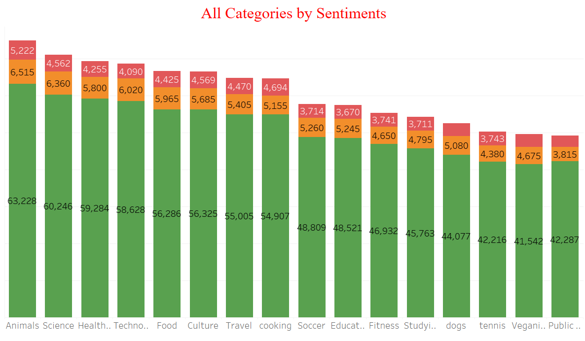
All of these categories have a positive sentiment, with over 90% of posts being positive.

Slide 9
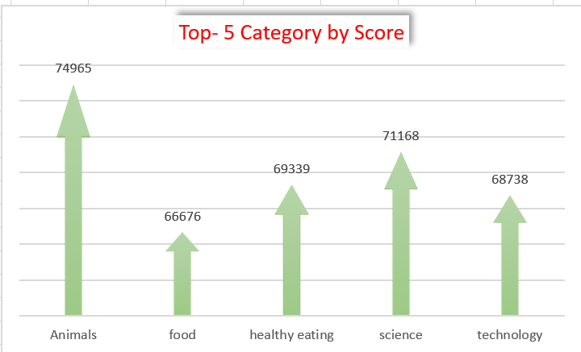
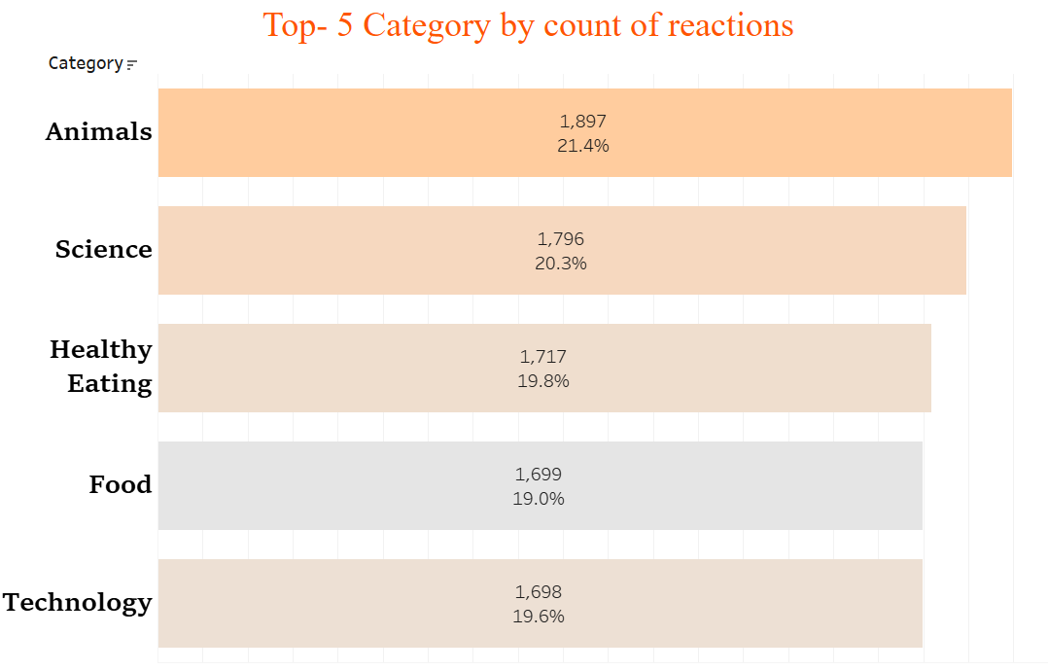

The top 5 categories on our platform are: animal, science, healthy eating, technology, and food.

Slide 10
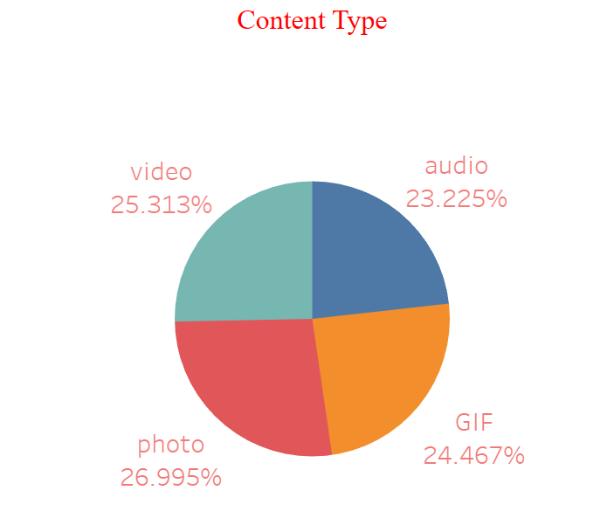
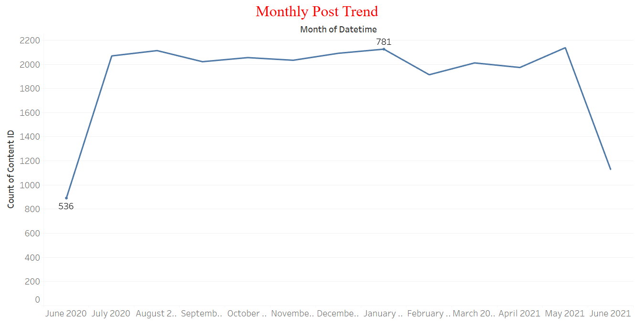
The month with the most posts was May 2021, and the month with the fewest posts was June 2020.
The most common category type is photos, followed by videos, GIFs, and audio.

Slide 11

Our platform is a valuable resource for people who are interested in sharing positive and uplifting content.
The top 5 categories on our platform are: animal, science, healthy eating, technology, and food.
The most common category type, photos, suggests that our users are visual learners who enjoy seeing images and videos.
Our platform is growing in popularity, with a peak in Jan 2021.
Summary

Slide 12
Thank you!
ANY QUESTIONS?

